Slide 1
Food security town hall meeting IV
Preliminary/DRAFT
Virgin Islands agricultural plan

Slide 2
AGENDA
Overall Objectives of the Plan
Introduction of Task Force Members
Why are we here?
Act 8404 – a mandate to create a
Comprehensive Agricultural Plan for the Territory
Inputs to our Process
Plan Recommendations Based on Mandate Categories
Additional High Priority Recommendations
Resources for Implementation of the Plan
Questions

Slide 3
AG Plan OBJECTIVE
To develop a plan that will increase agriculture productivity, sustainability and profitability in the Territory so that food security and sovereignty are not just labels but a true reflection of the reality of people's lives of the Virgin Islands.

Slide 4
Task force members
Dr. David Hall, President – University of the Virgin Islands
The Honorable Commissioner Positive T.A. Nelson – VI Department of Agriculture
Dr. Kendra Harris, Dean of the School of Business – University of the Virgin Islands
Dr. Usman Adamu, Dean of the School of Agriculture – University of the Virgin Islands
Assistant Commissioner Diana Collingwood – VI Department of Agriculture
Deputy Commissioner Hannah Carty – VI Department of Agriculture
Harith Wickrema, President – Island Green Living Association & Philanthropist

Slide 5
ACT 8404
The Act mandated that Positive T.A. Nelson, Commissioner of the Virgin Islands Commissioner Department of Agriculture, and Dr. David Hall, President of the University of the Virgin Islands, work to develop a comprehensive Agricultural Plan for the Territory.
The final agriculture plan must contain policy and funding recommendations to support and expand the local food system, increase locally grown food production, provide a food security plan and include short-term and long-term goals.
The Act is comprised of eight (8) mandates.
Signed into law on December 11, 2020, by the Honorable Governor of the Virgin Islands, Albert Bryan, Jr., and passed by the 33rd Legislature.
Sponsored by:
Senators: President Donna Frett-Gregory, Janelle K. Sarauw, Kurt A. Vialet,
Dwayne M. DeGraff, Athneil “Bobby” Thomas and Allison L. DeGazon
Co-sponsor: Steven D. Payne, Sr.

Slide 6
The eight mandates of ACT 8404
I.
A comprehensive regulatory component for the territory's farming industries
II.
Business models for profitable and sustainable community-based local food and farming businesses
III.
A plan for the development of a position for and the hiring of a Local Food and Farm coordinator
IV.
The creation of a local food and farm fund from voluntary sources to support initiatives, and agriculture-related activities

Slide 7
The eight mandates of ACT 8404
V.
Recommendations for the establishment of a local food and farm advisory committee, composed of seven members
VI.
The creation of a "local food symbol" that can be placed on stickers, posters, stamps, etc. for sale;
VII.
The Development of education and training programs for local food farmers, entrepreneurs, and processors
VIII.
The collection of data, creation of benchmarks, and assessment of progress on the building of the local food and farm economy

Slide 8
Activities Performed BY THE TASK FORCE
Convened a meeting of national experts on tropical agriculture
Collected and reviewed previous Agriculture Plans for the Territory, which were issued in 1999 and 2008
Secured and analyzed the latest Agriculture Census, which the USDA developed in 2018
Hired Ms. Jacquette Maynard to serve as Administrative Assistant to the Task Force
Created a logo design
Developed an email address: agplan@doa.vi.gov
Established a webpage www.doa.vi.gov/ag-plan
Visited a FarmPod on St. Croix to review the role of a Controlled Environment Agriculture to increase productivity
Conducted 3 Town Hall Meetings for Farmers on St. Croix, St. Thomas and St. John

Slide 9
Activities Performed BY THE TASK FORCE
Developed and distributed three (3) Active Engagement Surveys:
- Farmer’s Survey Responses = 169
- Community Survey Responses = 246
- Food Retailers & Restaurateurs Survey Responses = 5
The eight (8) subcommittees made weekly presentation on their progress and recommendations.
Received and reviewed the Economic Development Authority’s commissioned feasibility study for a food processing plant on St. Croix
Reviewed Vision 2040 and its implications for increasing agricultural productivity from an economic impact perspective
Interviewed former Commissioners of Agriculture:
- Dr. Louis Petersen
- Mr. Carlos Robles

Slide 10
Activities Performed BY THE TASK FORCE
Selected four (4) External Reviewers to assess a draft version of the Plan:
Dr. Louis Petersen, Assistant Director – UVI Cooperative Extension Services and former Commissioner of Agriculture
Dr. Allison DeGazon, Director & Former Senator – Bureau of Economic Research
Dr. Nicholas Comerford, Dean and Director of Human Resources & Agriculture – Research and Cooperative Extension at the University of Hawaii, the College of Agriculture and Human Resources
Dr. Moses Kairo, Dean of the School of Agriculture and Natural Sciences Research Director, 1890 Land Grant Programs Administrator, UMES Extension – University of Maryland Eastern Shore

Slide 11
Activities Performed BY THE TASK FORCE
Collaborated with the VI Department of Education on the Education & Training recommendations
Secured the services of Mr. Errol Chichester to perform outreach on the Farmer’s Survey
Selected three (3) local Graphic Design Artists to create the Local Food Symbol
Secured the services of the UVI Caribbean Green Technology Center to conduct a study on irrigation and water supply
Secured the services of AppleSeed to conduct a study on the economic impact of agriculture productivity
Collaborated with USVI Hotel and Tourism Department and the Chambers of Commerce on the distribution of the Food Retailers and Restaurateurs Survey:

Slide 12
RESULTS – FARMER’S ENGAGEMENT SURVEY
What support would you need from the local government to increase farm productivity?

Slide 13
RESULTS – FARMER’S ENGAGEMENT SURVEY
Which category of farming do you produce?

Slide 14
RESULTS – FARMER’S ENGAGEMENT SURVEY
On average, how much of your farm is in production?

Slide 15
RESULTS – FARMER’S ENGAGEMENT SURVEY
Where do you sell your crops/produce?

Slide 16
RESULTS – FARMER’S ENGAGEMENT SURVEY
Would you be interested in participating in an Agriculture Training Outreach Program?

Slide 17
RESULTS – FARMER’S ENGAGEMENT SURVEY Demographics
On which island is your farm located?

Slide 18
PRIMARY Concerns - Food security TOWN HALL MEETINGs
Irrigation:
“We need to address the realm of water conservation and soil conservation. The fact that our trees are not respected, and our trees are not treasured. Without trees, without the canopy, we cannot have water conservation at its purest form. We cannot have soil conservation in its purest form.”
Funding:
“We also need support, not just bulk buying or just making things more available and more affordable for farmers. I believe that the excise tax needs to be more of a streamlined process.”
Education, Training Support and Access:
“How can we bring the requisite focus of agriculture on the issue of education? How do we really look at developing the ecosystem of engaging of education?”
Backyard Farming:
“There are a lot of homeowners or residents who have plants or orchards within the backyard. That is a vital resource that can be added to the Plan and the food security in the territory.”
Staffing at VIDA:
“The Department of Agriculture had staff that assisted the farmers. Now, there is hardly any employees at the Department that can help farmers”
Organic Growers:
“ We hardly hear of any benefits to being organic. It is such a very strong market, but we have small market her, so the farmers that are beginning to use organics needs support to become organic growers, even if they're not certified organic.. A lot of people want organic slips like plants to plant and want to know that it's not polluting or any of that”

Slide 19
COMMENTS/FEEDBACK: FARMERS SURVEY
“Investment in increasing production so we can import fewer vegetables and herbs. Incentivize restaurants and grocery stores if they buy and use local, they will get some sort of benefit.”
“What are the Plans for Information Sharing?”
“I understand that there is a Plan in every Administration; however, the VI Ag Dept. needs to be more encouraging, supporting and assistive of all small farmers. We need help in cultivating and developing land through funding.”
“
”Like other producers, I am trusting that this process will lead to increased concrete support and progress for the Agricutural industry.”

Slide 20
COMMENTS/FEEDBACK: FARMERS SURVEY
“I would like to see funds that Dept of Ag receives utilized in a way that will give farmers an outlet to sell produce as well as a processing center that could be used for huge crops such as mangos (for possible export). The funds seem to be there, just not utilized efficiently and consistently.”
“When you are offering classes or training can you incorporate a class for the people who have other jobs besides farming, I do backyard farming, but I have a full-time job too, its difficult to attend a class at 10 am on the week-days.”
“To expand farming in the territory, where will we get and store enough fresh water to irrigate all these crops?”
“I would like to have my own farmland other than my back yard for farming, and to have the Agriculture Department continue to assist farmers with rich soil.”

Slide 21
PRELIMINARY AGRICULTURAL PLAN PRESENTATION
Recommendations to the 8 mandates
High Priority Recommendations
Next Steps

Slide 22
Mandate 1: REGULATORY FRAMEWORK
SUBCOMMITTEE
Chairperson: Hannah Carty Deputy Commissioner VI Department of Agriculture
Member(s): Positive T. A. Nelson Commissioner VI Department of Agriculture
Jawanza Wallace-Hilaire Director, Agricultural Development VI Department of Agriculture
Christopher McDonald Research Scientist USVI Hazard Mitigation & Resilience Plan
Upcoming Events: VI Agriculture Regulatory Round Table

Slide 23
Mandate 1: REGULATORY FRAMEWORK
RECOMMENDATIONS:
Provide funding for each of these legislative initiatives since they are relevant and meaningful ways to increase agriculture productivity or enhance the state of agriculture in the Territory.
Example of Legislation passed without funding:
1. Land Management: Organic Materials Recycling Program (RENAME)
a. Provide Annual budget for an Organic Materials Recycling Program including:
i. Territorial Personnel or Service Contract
1. Office Coordinator
2. Composter/Mulchers
3. Laborer/Distributer
ii. New Equipment

Slide 24
Mandate 1: REGULATORY FRAMEWORK
RECOMMENDATIONS:
Amend or repeal existing laws that no longer provide any meaningful contribution to agriculture.
Example of Amend/Repeal Items:
1. Unfunded Items:
a. If the body decides not to fund any of the aforementioned items that they be repealed or amended.
To streamline the use of the VI Code regarding agriculture provisions, we recommend that certain provisions are duplicative and should be combined or condensed. Part of the ongoing process of the Task Force is to determine which legislations will be combined.
Since this Agriculture Plan provides a comprehensive approach to the development of agriculture in the Virgin Islands, it is recommended that this report is enacted by the Legislature, signed into law by the Governor and funded appropriately.

Slide 25
Mandate 2: BUSINESS MODELS FRAMEWORK
SUBCOMMITTEE
Chairperson: Dr. Kendra Harris - Dean of the School of Business University of the Virgin Islands
Member(s): Diana Collingwood - Assistant Commissioner VI Department of Agriculture
Harith Wickrema - President and Philanthropist Island Green Living Association
Consultant(s): - Stafford Crossman, Associate Director, Cooperative Extension Services - Josh Walton, District Director, Georgia SBDC
- Walt Moore, Area Director, Georgia SBDC
- Jim Johnson, Region Director, SCSU Region Small Business Development Ctr.
- Francisco Depusoir, Chair Accounting and Finance, and farmer
- Dr. Paul Flemming, Chair Management and Marketing, and former VIEDA Manager
- Dr. Eustace Esdaille, Director, Executive MBA Program
- Dr. Renel Smith, Assistant Professor, Information Systems and Technology

Slide 26
Mandate 2: BUSINESS MODELS FRAMEWORK
RECOMMENDATIONS:
Traditional Small Private Businesses:
The Small Business Development Center, Cooperatives and any other entities, will work together to conduct consulting and training directed specifically to farmers to assist with farmers' accounting, financing, bookkeeping, and other related business records needs, under an Agriculture Business Center.
Communication has been made with the Cooperative Extension Service to work with the SBDC to provide assistance where needed, especially as it relates to specific farm related technical issues.
Farming Cooperatives: With this initiative VIDA will promote and help to facilitate the creation of Farming Cooperatives.
Advantages of Cooperatives:
Sharing of best practices
Increased farming and business operations knowledge
Increased buying power based on collective action
More competitive selling rates based on collective action
Possibly Increased/better usage of governmental resources (e.g., equipment)
Shared expenses of farm supplies and equipment

Slide 27
Mandate 2: BUSINESS MODELS FRAMEWORK
RECOMMENDATIONS:
This approach is needed to stimulate more “controlled environment agriculture” in the Territory. Local farmers do not have the capital and expertise to invest in substantial aquaponics and hydroponic farming processes. Yet, with government investment and technical support from the School of Agriculture at UVI, these local farmers can flourish and contribute to increasing agriculture productivity in the Territory.
A revenue-sharing model or increased tax revenue can be part of the arrangement so the local government can continue to invest in the model.
Public-Private Agriculture Partnerships
This model has the greatest potential to increase productivity and transform the role of farming in the Virgin Islands with strategic investment by the government into specific farm operations and types of farming.
Incubator Program Recommendation: Should be funded and managed by the VI Department of Agriculture.
The Economic Development Authority (EDA) has begun developing programs such as a Processing Plant and the Clean Kitchen; of which the Task Force supports.

Slide 28
Mandate 2: BUSINESS MODELS FRAMEWORK
RECOMMENDATIONS:
For any of these business models to operate effectively, there must be some fundamental requirements that all farmers adhere to, such as:
Farmers agree to engage in a minimum level of "continuous improvement" training practices regarding their farming strategies.
Farmers agree to report on authentic production/yield information so that the Territory's strategies are built on solid information that legitimizes projections for progress towards food sovereignty.
Farmers engage in standard business practices (e.g., tax reporting).
In addition to Farmers’ efforts, we understand that farm support and communication from the Virgin Islands Department of Agriculture will be critical to the success of any business model.

Slide 29
Mandate 2: BUSINESS MODELS FRAMEWORK
RECOMMENDATIONS:
Other Considerations:
Below is a list of other business-related initiatives and approaches that the Legislature should consider that may enhance agriculture productivity in the Territory.
Providing incentives for local retailers and restaurants to buy local food instead of importing from outside the Territory.
Consider imposing import controls on certain crops, fruits, and other products for periods when those products are in abundance in the Virgin Islands.
Provide financial incentives for farmers' heirs so that it is more enticing for them to continue active farm production.
Ensure that all farmers are complying with USDA standards regarding safety and health. This will also assist farmers when exporting produce is standard practice.
Consideration should also be given to how to expand and include EXISTING farmers in the cultivation of cannibas, hemp, and hemp-related products market.

Slide 30
Mandate 3: LOCAL FOOD PROGRAM COORDINATOR
SUBCOMMITTEE
Chairperson: Dr. David Hall - President University of the Virgin Islands
Member(s): Hannah Carty - Deputy Commissioner VI Department of Agriculture

Slide 31
Mandate 3: LOCAL FOOD PROGRAM COORDINATOR
RECOMMENDATIONS:
The position of Local Food Program Coordinator, along with the Advisory Committee mandate in Act 8404 create a new approach to the advocacy, implementation and monitoring of agricultural productivity in the Territory.
The Farm Coordinator will be an employee in the Department of Agriculture but would report directly to and work very closely with the Advisory Committee that the Act recommends.
This candidate would work across the various stakeholder groups.

Slide 32
Mandate 3: LOCAL FOOD PROGRAM COORDINATOR
RECOMMENDATIONS:
Priority Duties:
With guidance from the Advisory Committee, monitor the implementation of the Agricultural Plan
Working closely with the Department of Agriculture and the University, to develop specific outreach efforts and trainings to encourage more individuals to engage in home and community gardening
Ensuring that the annual data collection process is occurring in a professional and thorough manner. (The person would not collect the data but hire a person or entity to collect the data)
Cultivate more trusting relationship across the various stakeholder groups involved in the local industry (farmers, consumers, business, education, etc.)
Develop a local fundraising strategy for the Local Food and Farm Fund
Promote the local farm symbol and ensure it is being used across the various stakeholder groups
Identify and share grant opportunities with farmers and other appropriate entities
Promote the benefits of Farm Cooperatives

Slide 33
Mandate 4: LOCAL FOOD FARM FUND
SUBCOMMITTEE
Chairperson: Positive T. A. Nelson - Commissioner VI Department of Agriculture
Member(s): Dr. Usman Adamu - Dean of the School of Agriculture University of the Virgin Islands

Slide 34
Mandate 4: LOCAL FOOD FARM FUND
RECOMMENDATIONS:
We recommend that the Agriculture Advisory Committee be responsible for creating a 501(C) (3) Foundation, similar to the University of the Virgin Islands Foundation, that will serve as the legal entity into which funds are deposited, invested, and disbursed.
The Advisory Committee will serve as the Board of Directors for the foundation and thus for the fund. There should be an annual solicitation of contributions in addition to grants and other major gift solicitations.
The Advisory Committee will compile a list of agriculture initiatives and projects that the funds would be used to support.
The funds should have a particular focus on encouraging home gardens and community farming to supplement the work of the farmers in the Territory as another means of obtaining food sovereignty.
An annual reporting to the Legislature of the amount of funds raised and disbursed should occur as mandated.

Slide 35
Mandate 5: ADVISORY COMMITTEE
SUBCOMMITTEE
Chairperson: Diana Collingwood - Assistant Commissioner VI Department of Agriculture
Member(s): Positive T. A. Nelson - Commissioner VI Department of Agriculture
Dr. Usman Adamu - Dean of the School of Agriculture University of the Virgin Islands

Slide 36
Mandate 5: ADVISORY COMMITTEE
RECOMMENDATIONS:
Establishment of a Local Food and Farm Advisory Committee to consist of the following seven members as mandated by ACT 844 Bill No. 33-0376:
I.
Commissioner of the Department of Agriculture
Executive Director of the Economic Development Authority
President of the University of the Virgin Islands
UVI Dean of Agriculture
Farmer from STX appointed by the Governor
Farmer from STT appointed by the Governor
Farmer from STJ appointed by the Governor
II. To ensure that there is representation from other agencies involved in the agriculture industry, it is recommended that the Commissioner of the Department of Natural Resources be appointed to the Advisory Committee.
III. Due to the high emphasis on training and educational enhancement in the agricultural field. It is recommended that the Commissioner of Education be appointed to the Advisory Committee.

Slide 37
New advocacy structure for agriculture
Governor of the Virgin Islands
VI Department of Agriculture
Legislature of the Virgin Islands
Advisory Committee
- Commissioner of the Depart. of Agriculture
- Executive Director of the Economic Development Authority
- President of the University of the Virgin Islands
- UVI Dean of Agriculture
- Farmer from STX appointed by the Governor
- Farmer from STT appointed by the Governor
- Farmer from STJ appointed by the Governor
- Commissioner of the Department of Natural Resources
- Commissioner of the Department of Education
Local Food Farm Coordinator
Food Fund

Slide 38
Mandate 6: LOCAL FOOD SYMBOL
SUBCOMMITTEE
Chairperson: Dr. Kendra Harris - Dean of the School of Business University of the Virgin Islands
Member(s): Hannah Carty - Deputy Commissioner VI Department of Agriculture

Slide 39
Mandate 6: LOCAL FOOD SYMBOL
RECOMMENDATIONS:
Establish a brand and promote agriculture's benefits in the United States Virgin Islands.
Develop a very compelling and appropriate local food symbol that will be a marketing tool to convey the importance of food sovereignty in the Virgin Islands, encourage the importance of “home grown” produce, and elevate the importance of agriculture throughout the Territory.
The Task Force commissioned three local Graphic Design Artists to create a food symbol.
Create future opportunities to engage students around projects related to the local symbol.
Example: an essay contest that will include marketing strategies

Slide 40
Mandate 6: PROPOSED LOCAL FOOD SYMBOL
RECOMMENDATIONS:
SYMBOL #1
Jenne Dee Creative
SYMBOL #2
Joshua the Jenius
SYMBOL #3
Love Art Group

Slide 41
Mandate 7: EDUCATION AND TRAINING FRAMEWORK
SUBCOMMITTEE
Chairperson: Dr. Usman Adamu - Dean of the School of Agriculture University of the Virgin Islands
Member(s): Diana Collingwood - Assistant Commissioner VI Department of Agriculture
Harith Wickrema - President and Philanthropist Island Green Living Association
Consultant(s): - Stafford Crossman, Associate Director,
Cooperative Extension Services
- Dr. Louis Petersen, Assistant Director
UVI Cooperative Extension Services and former Commissioner of Agriculture

Slide 42
Mandate 7: EDUCATION AND TRAINING FRAMEWORK
RECOMMENDATIONS:
The Education and Training programs under this Plan for the local food farmers, entrepreneurs, and processors are critical to implementing the Plan and increasing agricultural productivity in the short and long term.
Farmer Education
To stimulate more productivity in the Territory, it is critical that more resources be devoted to farmer education for today’s farmers and future farmers. The farmer survey results indicated great receptivity to this need and was one of the top needs from the local government (69.74%).
Programs for Farmers:
Informal Education Program
Non-Formal Education and Training Programs

Slide 43
Mandate 7: EDUCATION AND TRAINING FRAMEWORK
RECOMMENDATIONS:
Informal Education Programs:
Informal learning activities should be encouraged and promoted among local farmers and growers to preserve and retain the beneficial traditional agricultural production system in the Virgin Islands.
It is recommended that Virgin Islands create education and training programs for Farmers, such as a ‘Grow VI Program’ that will be beneficial to existing and new Farmers. The program will allow people of all ages to learn about the various aspects of farming to become a commercial farmer and learn the skills to start a farm operation or work within the agricultural industry at a higher level.
Additional informal learning activities:
Conversation and Forum
Social Media and Messaging App, etc.
Mentoring and Volunteering
Book Clubs (Including eBooks)
Trips and Travel (Trade/Agriculture Shows, etc.)

Slide 44
Mandate 7: EDUCATION AND TRAINING FRAMEWORK
RECOMMENDATIONS:
Non-formal education/training programs
Non-formal education and training programs for local farmers, agricultural entrepreneurs, including food processors, and other related stakeholders are available at UVI and in various local government departments and agencies. However, these programs need to be promoted and their accessibility and funding improved in local budget allocations.
The Cooperative Extension Service (CES) of the UVI School of Agriculture is an outreach unit with expertise and experts in non-formal education/training programs and services for farmers, home gardeners, and residents.
The main programs of the Cooperative Extension Service are:
Agriculture and Natural Resources
4-H/Family and Consumer Science
Computer Training and Technology
Community Economic Development (planned)

Slide 45
Mandate 7: EDUCATION AND TRAINING FRAMEWORK
RECOMMENDATIONS:
Non-Formal Education/Training Programs
The VI Department of Agriculture Programs and Services such as land development and maintenance, beekeeping training, record keeping, backyard farming, composting, and more are very important to Farmers
In summary, the informal and non-formal education programs are useful to current Farmers and the formal education programs are for preparing future Farmers. It will be offer better promotion of the programs for Farmers to take advantage.

Slide 46
COMPREHENSIVE AGRICULTURE EDUCATION FOR THE VIRGIN ISLANDS
College Level:
The certificates and associate of applied science degrees are designed to prepare students for entry-level jobs and career opportunities in agriculture and agriculture-related fields.
Programs: Animal science, Agricultural Business, Agrotourism, Agroecology, Aquaculture, Nursery Management, Forestry, Horticulture, Cannabis Science, Regulatory Science, General Agriculture
College
High School
Middle – High School:
The Virgin Islands Agricultural Education System Curriculum Frameworks developed in 2002 by P.E.A.C.E. International LLC contains all the necessary courses that meet the standard and criteria for an agricultural education program.
Middle School
Elementary
PreK
PreK – Elementary:
The Plan recommends establishing and funding the USDA Agriculture in the Classroom (AITC) program/initiative in the Virgin Islands at the pre-kindergarten and elementary levels.

Slide 47
Mandate 8: DATA AND ANALYSIS FRAMEWORK
SUBCOMMITTEE
Chairperson: Dr. David Hall - President University of the Virgin Islands
Member(s): Dr. Usman Adamu - Dean of the School of Agriculture University of the Virgin Islands
Dr. Kendra Harris - Dean of the School of Business University of the Virgin Islands

Slide 48
Mandate 8: DATA AND ANALYSIS FRAMEWORK
RECOMMENDATIONS:
Develop a systematic approach to data collection be developed and funded.
Utilize list of data collection points be adopted to collect this information annually, except during the years when the Agriculture Census is being conducted.
Agricultural Advisory Committee will commission an annual data collection process and create a database to collect necessary information to measure agricultural productivity.
Agricultural Advisory Committee will conduct an annual assessment of the effectiveness of the Agriculture Plan on an annual basis and deliver a report to the Legislature and the Governor

Slide 49
Mandate 8: DATA AND ANALYSIS FRAMEWORK
RECOMMENDATIONS:
Develop the following benchmarks to determine whether progress is being made under the Plan to achieve food security.
Increasing local agricultural productivity by 2% each year in order to increase locally consumed products from 3% to 35% according to the goal in Vision 2040.
Increasing the acreage in production by 10% each year.
Increasing the number of licensed farmers by a 5% each year.
Increase the number of individuals engaged in home gardening and community growing by 10% each year.
Reducing the number of agricultural imports by 2% each year.

Slide 50
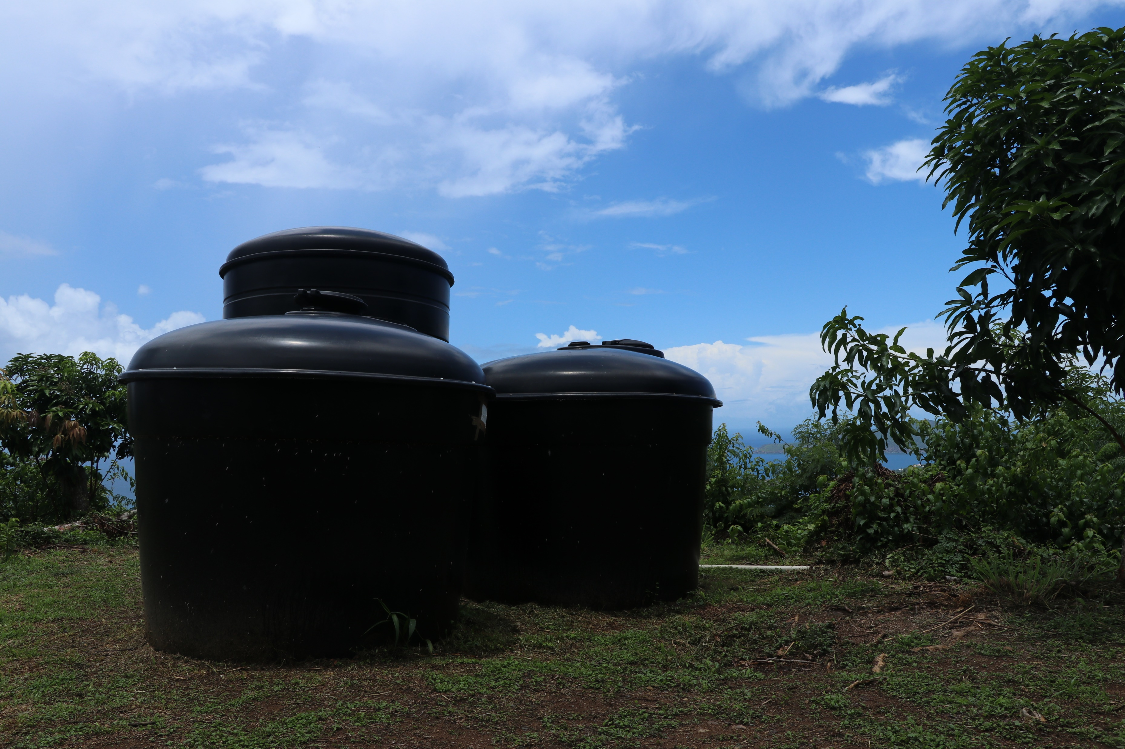
HIGH PRIORITY recommendations
1.
COMPREHENSIVE IRRIGATION SYSTEM AND WATER SUPPLY
Include recommendations from the UVI Caribbean Green Technology Center regarding measuring, increasing and enhancing the supply and distribution of water to farmers.

Slide 51
HIGH PRIORITY recommendation water security: short term
General
Create water management board
Water Resources
Fix and repair existing Infrastructure
Improve Pond Capacity – dredging, relining, investing in equipment
Expand usage of publicly owned cisterns
Distribution Network
Repair distribution networks
Back up power supply for pumps (solar + battery if possible)
Purchase water truck for Bordeaux
Farmers
Demonstration projects and training on water conservation and irrigation methods
Create a data repository on climate impacts, location of water resource assets and status, solutions, etc.

Slide 52
HIGH PRIORITY recommendation water security: medium term
Water Resources
Improve drainage capacity of guts and clean up debris
Institute and support Water Co-Ops and VI Soil and Conservation District
Distribution Network
Increase amount of water trucks
Farmers
Water subsidy to purchase water during drought
Water monitoring and new irrigation technologies for community gardens farmers on St. Croix
Capacity
Create short and long-term plans for drought and soil management
Increase technical capacity at VIDA.

Slide 53
HIGH PRIORITY recommendation water security: long term
Water Resources
Desalination plant for Bordeaux
Work with U.S. Army Corps of Engineers to Repair Creque Dam
Expand NOAA Co-Op weather network to better understand drought processes
Farmers
Create water management plan and database of water conservation technology best practices
Create network of smart irrigation tools for remote sensing of soil and plant conditions
Capacity
Create a VIDA/CES Vocational Training Program.

Slide 54
HIGH PRIORITY recommendation water security: long term
These recommendations provides an overview of the water system for farmers in the USVI.
It shows that, in order to achieve water security, it is important to:
Monitor the sources and ensure that they are well managed
Monitor the distribution network
Maintain water resources and distribution infrastructure
Work with farmers to ensure that they use and/or have access to the latest water conservation technologies

Slide 55
HIGH PRIORITY recommendations
1I. INFRASTRUCTURE SUPPORT
III.
INCREASE PERSONNEL AT VIDA
IV.
STRATEGIC ORCHARD DEVELOPMENT INITIATIVE
Key strategic position to be filled and appropriate funding provided to the VIDA regularly.
Plant pathologist,
Soil and water conservationists,
Soil scientist,
Entomologist,
Lab Technicians,
Ag Law Enforcement Officer.
Tracts of governmental farmland be set aside for the specific development of fruit orchards. These initiatives can increase local productivity and be a source for the eventual development of a food processing plant.
Farmers will be selected to develop their orchard on leased farmland. There will be provisions for funding.
The Department of Agriculture should be provided the funds to significantly increase its equipment pool and provide personnel to operate key equipment to support agriculture development. (for example, tractors, lawn preparation, bulldozers, traxcavator).

Slide 56
HIGH PRIORITY recommendations
V.
TOOLS AND EQUIPMENT
VI.
TECHNOLOGY INNOVATION
The use of technology in the field of agriculture has become fundamental to safety, productivity and traceability. The traceability and monitoring of food products is becoming a new reality for farmers to embrace due to legislation like the Food Safety and Modernization Act that addresses the traceability of farm products from the field to the family table.
The Virgin Islands Department of Agriculture should be provided with the resources to acquire the tools and equipment that will help facilitate farmers' work.

Slide 57
Mandate 8: DATA AND ANALYSIS FRAMEWORK
RECOMMENDATIONS:
Develop the following benchmarks to determine whether progress is being made under the Plan to achieve food security.
Increasing local agricultural productivity by 2% each year in order to increase locally consumed products from 3% to 35% according to the goal in Vision 2040.
Increasing the acreage in production by 10% each year.
Increasing the number of licensed farmers by a 5% each year.
Increase the number of individuals engaged in home gardening and community growing by 10% each year.
Reducing the number of agricultural imports by 2% each year.

Slide 58
RESOURCES FOR PLAN IMPLEMENATION
Necessary Resources for Plan Implementation:
The Plan will require significant governmental investment supporting one-time and recurring recommended provisions.
The Task Force has developed some tentative budget estimates and it will develop a final budget request after receiving input from the Farming Community.

Slide 59
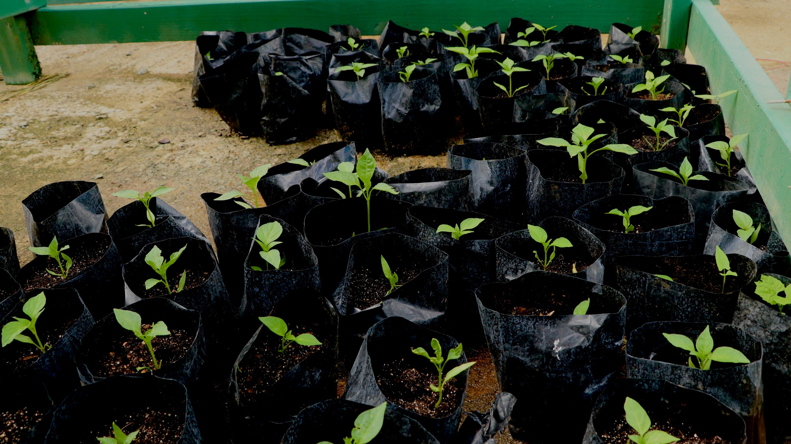
NEXT STEPS
Distribute the results of the Farmers Survey and a copy of the complete PowerPoint Presentation to the Farming Community.
Edit the Plan with Farmer’s comments and recommendations from the Town Hall Meeting
Solicit and receive additional input and suggestions from the Farming Community
Finalize the draft Plan
October 11, 2021: Present Plan to Governor and the Legislature

Slide 60
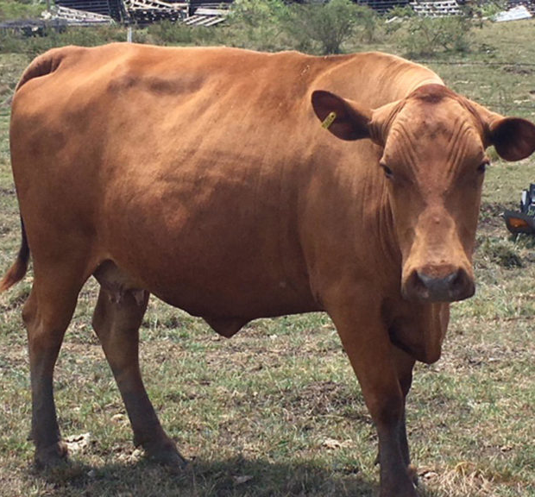
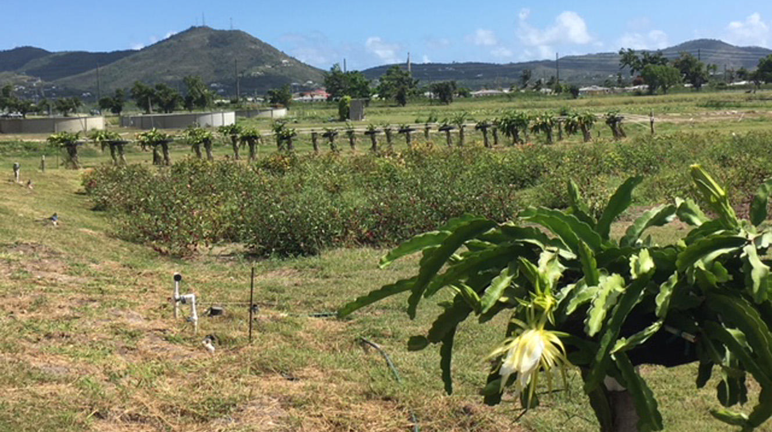
Discussions/ Questions/ comments

